Slide 1


1) Please sign-in in the “Chat Box”
Welcome to the LARC
LS #3
2) Please rename yourself with your site location code and actual name / facility name
Site | Location Code
BRIDH | BRIDH
Budiriro | BUD
Chitungwiza | CHIT
Epworth | EP
Hatcliffe | HC
Hopely | HOP
Kwadzana | KWAD
Mbare | MBA
NMRL | NMRL
Overspill | OS
Pari | PARI
PSI Lab | PSI
Seke North | SN
St. Marys | SM
Zengeza | ZEN

Slide 2


It’s HERE
On Your Screen
LS #3 – September 14-16

Slide 3


Slide 4

Welcome

Slide 5
Dr. Junior Mutsvangwa
Kudos
Mr. Japhet Mabuku

Slide 6

PAGER – Wednesday, September 16
Purpose:
To provide a guided approach to QI Initiative Aim #3 – Viral Load Coverage
  Define / Measure / Analyze / Improve Phase – CHANGE Menu, CHANGES Tested = PDSA
Agenda:
Welcome / Icebreaker The Great Renaming
PDSA Worksheet Plans Debrief
PDSA Worksheet Plans Refined, based on Feedback Data Collection Clarification / Q & A
QI Panel – Special Guests
Farewell – See you on September 30
Ground Rules:
Begin & end on time, Respect for all persons & all thoughts, Encourage engagement & participation, Keep audio on mute unless speaking / Raise hand to share or put question in chat box
Expected Outcomes:
Deliverables:
  CHANGES Selected
  Test CHANGES - PDSA Worksheet
  Data Collection Plan

Slide 7
The Great Renaming

Slide 8
6 Simple Steps
to Change your Name in the Zoom Participant List

Slide 9
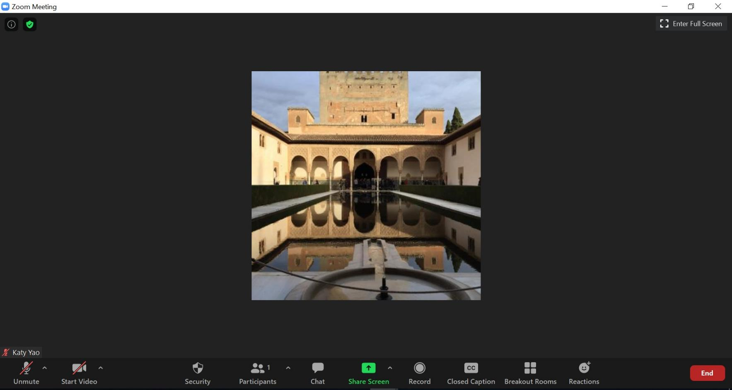
Step 1 – Click Participants (by the chat box) at the bottom of the screen

Slide 10
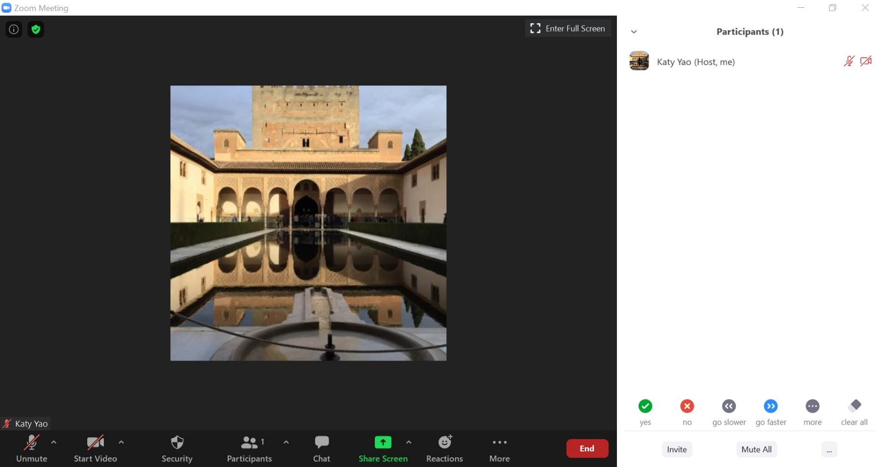
Step 2 – Participant panel opens. Find your name.

Slide 11
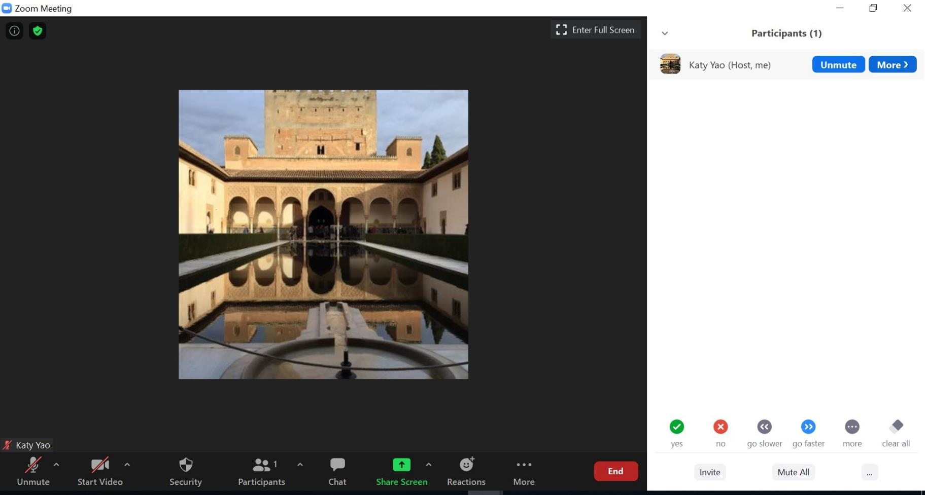
Step 3 – Put cursor by your name and click More

Slide 12
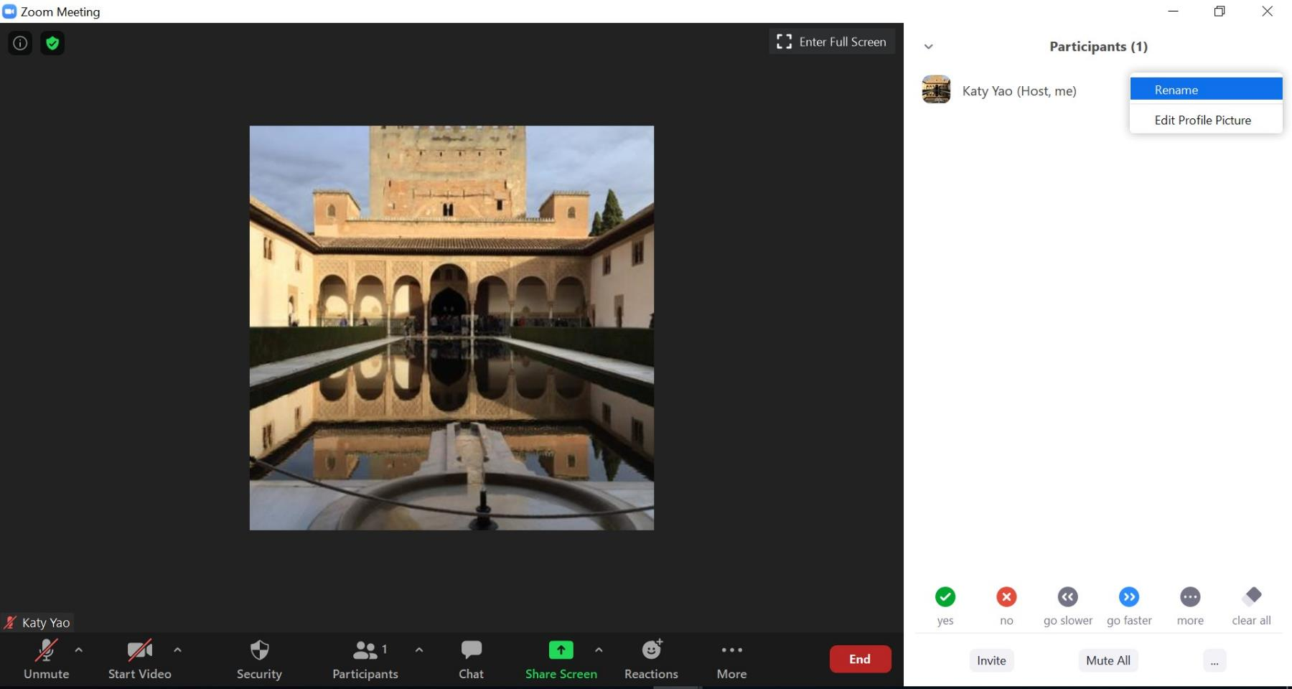
Step 4 – Click Rename

Slide 13
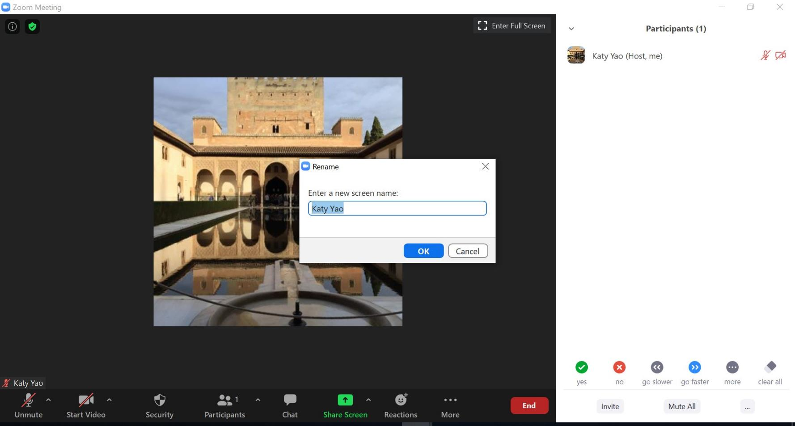
Step 5 – Type a new name in the Rename box

Slide 14
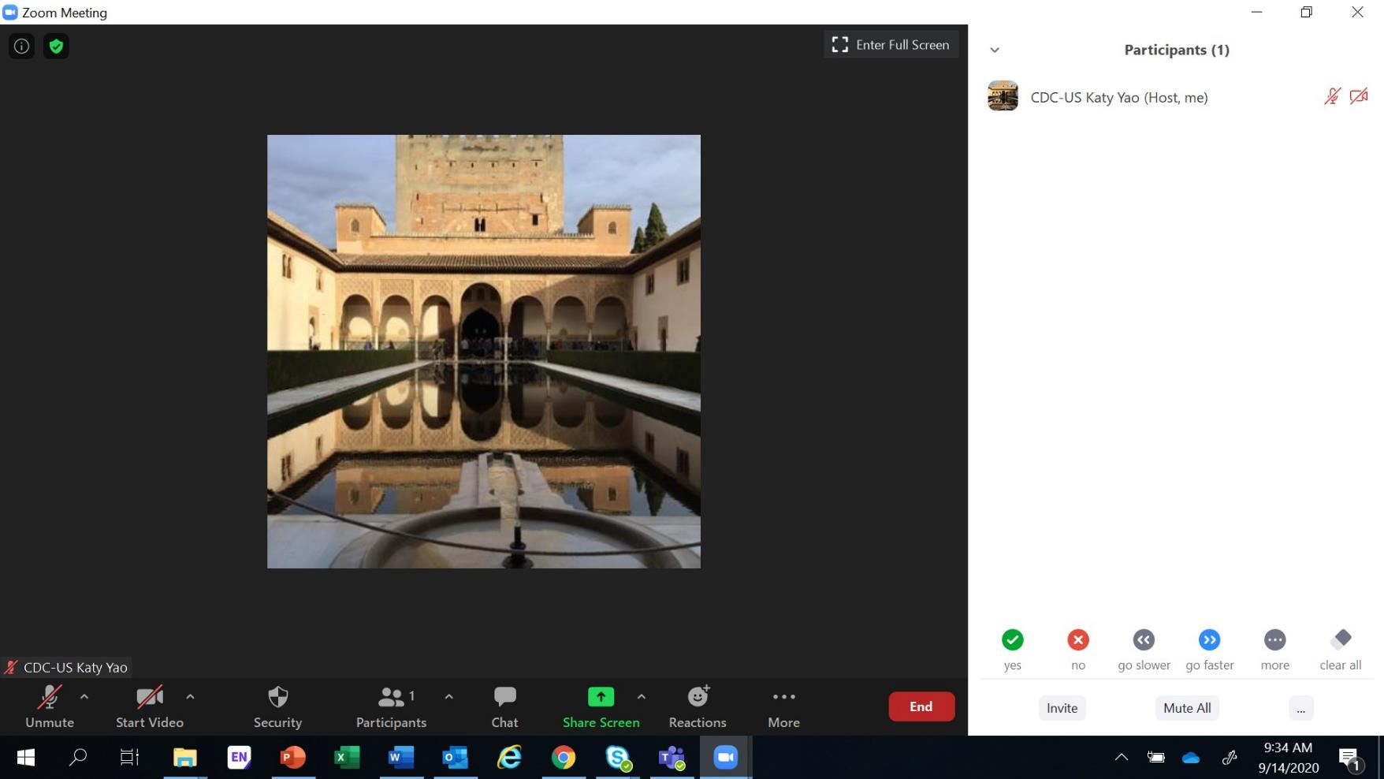
Step 6 – You have now changed your name in the Participant List

Slide 15
Introductions

Slide 16


Turn on Your Camera
Smile
Wave
Let us see your smiling face

Slide 17

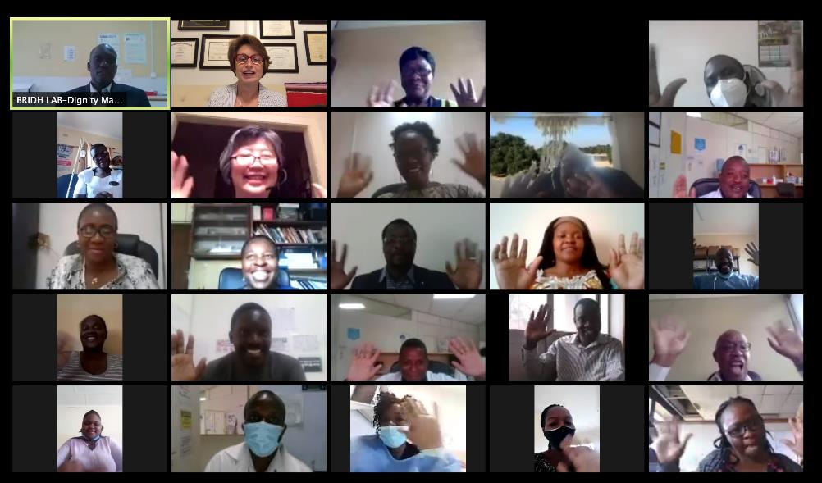

Slide 18

Begin with the End in Mind

Slide 19

Aim #3: Improve
Viral Load Coverage

Slide 20


GOAL:
Be ready to begin testing CHANGES on September 21

Slide 21

Select a CHANGE to test
VOC
RCA
OFI
Deliverables for LS #3
Detailed PDSA Worksheets
Data Collection Plan

Slide 22
Facility Name:
CHANGES to Test
Process Map – Opportunities for Improvement (OFI)
1.
2.
3.
Voice of Customer (VOC)
1.
2.
3.
Root Cause Analysis (RCA)
1.
2.
3.

Slide 23
Project Deliverables
DUE SEPT 2
Define/Measure/ Analyze
DUE SEPT 14
Learning Session 3 Improve
DUE AUG 26
Define/Measure
DUE SEPT 30
Improve / Control
q Process mapping (current, updated COVID) q Problem Statement q Baseline Metric q Presentation | q Voice of the customer q Analyze tools (Fishbone, 5 whys, etc.) q Presentation | q 5 S q Linkage of Identified OFI, VOC, & RCA to CHANGES q Presentation | q CHANGE Tested (1 PDSA Evaluated per Week) q Data Collection – After Improvement q Presentation

Slide 24
PDSA Plans: Debrief

Slide 25



Pitfalls
Did not select one of the given CHANGES
Not thinking big enough – not looking at the entire process
PDSA Plan without adequate details

Slide 26
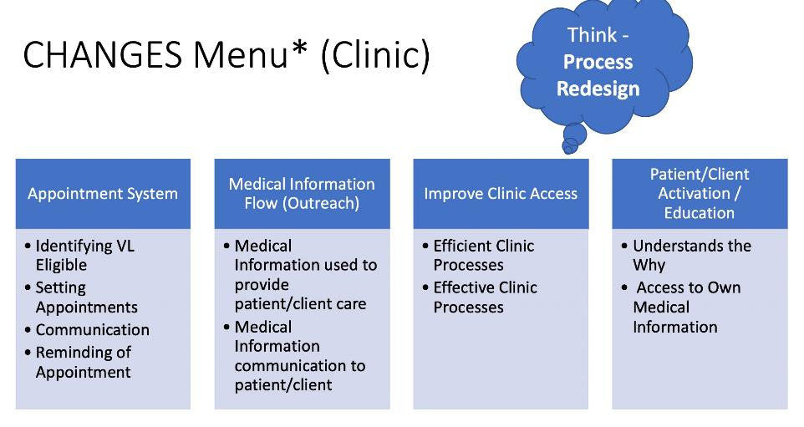
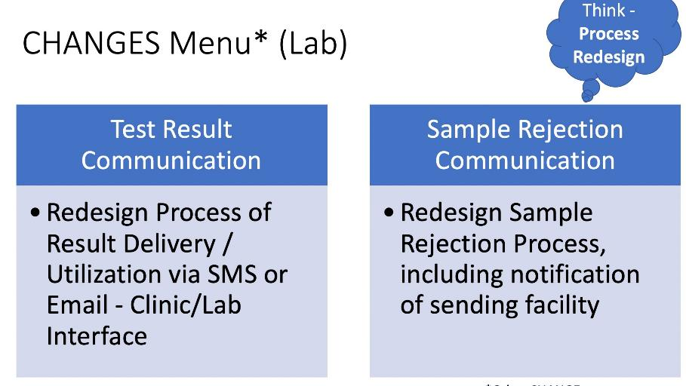
Given CHANGES
Select a given CHANGE

Slide 27












BEFORE PROCESS
VL appoint-
ments booked
Client
arrival at clinic
Sample collection, processing and storage
Result
receiving at clinic
Result
t-
Notification
of HVL clients
Sample Transport
Viral Load testing
Result reporting
documen
tation in EMR
HVL clients return to clinic for EAC within 30 days
LINK
LINK
IMPROVED PROCESS
Sample collection, processing and storage
Lab receives/ prints results in triplicates and
flags HVL; sends to DEC, EAC,
HVL focal person
Result document- tation in EMR
VL appoint-
ments booked
Client
arrival at clinic
Sample Transport
Viral Load testing
Result reporting
New Client
Notification Process
EAC team calls
clients upon receipt of HVL results (using script) to book EAC appointments
Expert clients
conduct physical tracing (community visit) if unable to reach clients
Clients given shortened TCA (30 days medication)
Clients presents
to clinic for EAC appointments
New Client Notification Process
27

Slide 28
PDSA Plans: Case Study #1

Slide 29
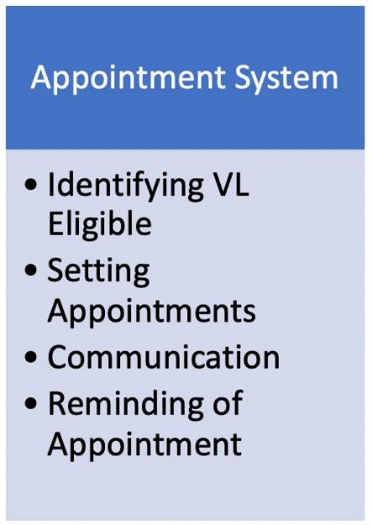
Facility Name:St Mary
CHANGES to Test
Printing the appointment list for the month
Identify clients due for VL when they come to the facility using cohort system
Clinicians collect VL sample Improve VL collection using the appointment list
Reminding clients of appointments for viral load sample collection
Process Map – Opportunities for Improvement (OFI)
Voice of Customer (VOC)
Long waiting the at the facility to access services
They do not know when VL is supposed to be collected
Root Cause Analysis (RCA)
Poor appointment system for VL collection
Lack of reminders for appointments of VL collection

Slide 30
Think - Process Redesign
CHANGES Menu* (Clinic)
Patient/Client Activation / Education
Appointment System
Medical Information Flow (Outreach)
Improve Clinic Access
Identifying VL Eligible
Setting Appointments
Communication
Reminding of Appointment
Medical
Information used to provide patient/client care
Medical Information communication to patient/client
Efficient Clinic Processes
Effective Clinic Processes
Understands the Why
Access to Own Medical Information
*Other CHANGE, upon request

Slide 31
Facility Name:
Worksheet for Testing Change
Initial PDSA
Aim #3: Increase VL coverage
Describe your first (or next) test of change Person responsible By When Where
Reminding clients of appointments using SMS for viral load sample collection Clinician
I week before At faciliy appointment
By When Where
1. Monthly Clinic
Pers
PLAN
Insufficient
List the tasks needed to set up this test of change
details
on responsible
1. Print the appointments list for the clients from EPMS
1. DEC
Predict what will happen when the test is carried out | Measures to determine if prediction succeeds
DO
Describe what actually happened when you ran the test:
STUDY
Describe the measured results and how they compared to the predictions:
ACT (select one)
q Adopt à Standardize
q Adapt à Describe what modifications to the plan will be made for the next cycle
q Abandon

Slide 32

Request: Include Introductions in the LARC Webinars
Why not make it a PDSA?
Request: Include Introductions in the LARC Webinars
Why not make it a PDSA?

Slide 33
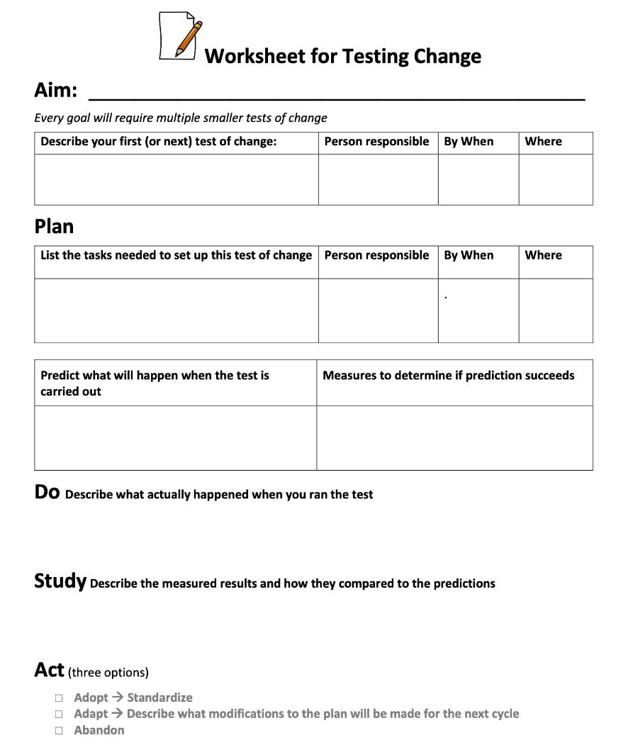
There’s a tool for that!
Workbook, p. 12

Slide 34
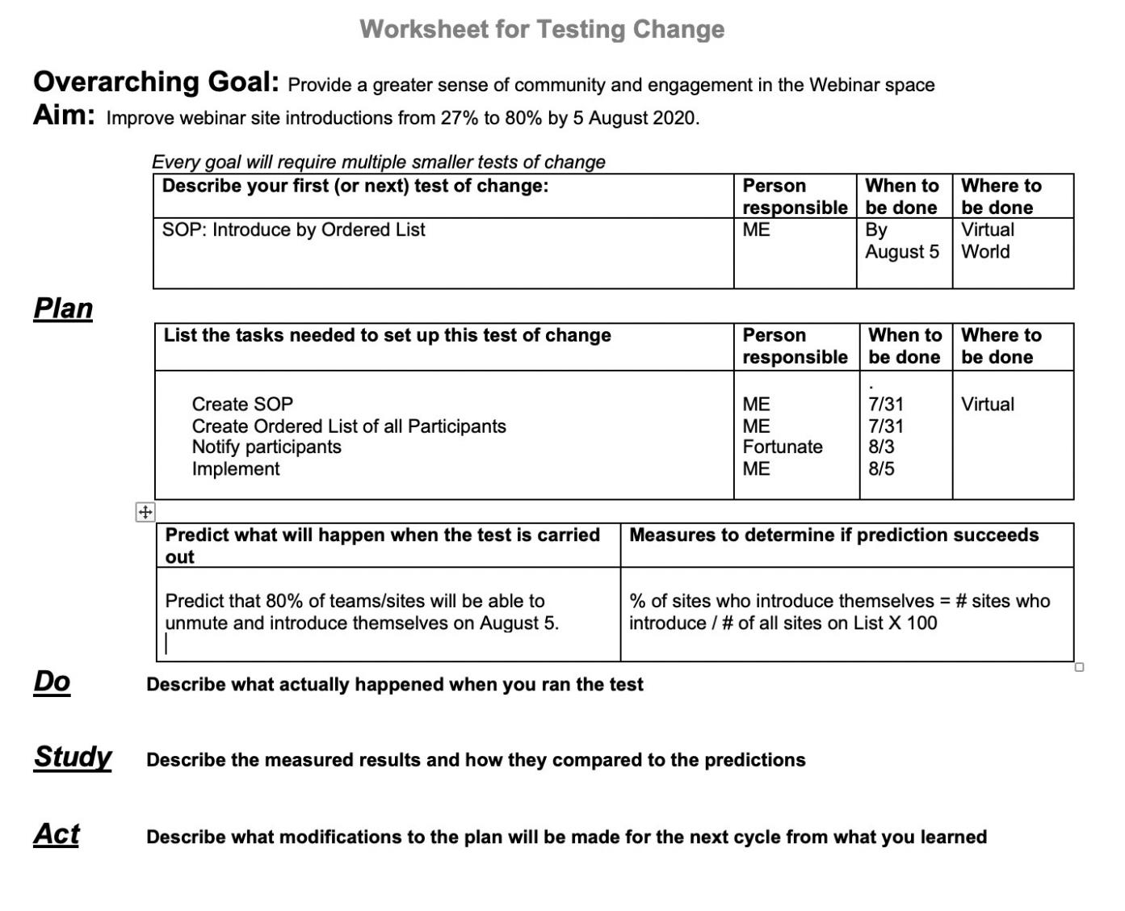
Study: 50% introduced
vs 80% predicted
Act: ADAPT

Slide 35
Plan
D
List the tasks needed to set up this test of change | Person responsible | When to be done | Where to be done
Create SOP | ME | 7/31 | Virtual
Create Ordered List of all Participants | ME | 7/31
Notify participants | Fortunate | 8/3
Implement | ME | 8/5
Predict what will happen when the test is carried out | Measures to determine if prediction succeeds
Predict that 80% of teams/sites will be able to unmute and introduce themselves on August 5. Predict that > 75% of participants will either be satisfied or very satisfied with the change in introductions. | % of sites who introduce themselves=# sites who introduce / # of all sites on List X 100 Customer Satisfaction Zoom Poll satisfaction rating
Do
Describe what actually happened when you ran the test
Study
Describe the measured results and how they compared to the predictions
Worksheet for Testing Change
Act
Describe what modifications to the plan will be made for the next cycle from what you learned

Slide 36

Worksheet for Testing Change
Overarching Goal: Provide a greater sense of community and engagement in the Webinar space
Aim: Improve webinar site introductions from 50% to 80% by 26 August 2020.
 |  | Person res nslble | When to be done | Whereto be done
P: Introduce by rdered List using Reminder (PD A 18) |  | ME | By August 26 | Virtual World
I+ | List the tasks needed to set up this test of change |  | Person responsible | When to be done | Whereto be done
 | Notify participants 2 days prior to Webinar Re-implement |  | Fortunate ME | 8/24 8/26 | Virtual
 | Predict what will happen when the test Is carried out | Measures to determine If prediction succeeds
 | Predict that 80% of teams/sites will be able to unmute and introduce themselves on August 26. Predict that> 85% of participants will either be satisfied or very satisfied with the change in introductions. | % of sites who introduce themselves = # sites who introduce/# of all sites on List X 100 Customer Satisfaction Zoom Poll satisfaction rating
Describe what actually happened when you ran the test
D
Study
Describe the measured results and how they compared to the predictions
Worksheet for Testing Change
Describe what modifications to the plan will be made for the next cycle from what you learned
Act

Slide 37
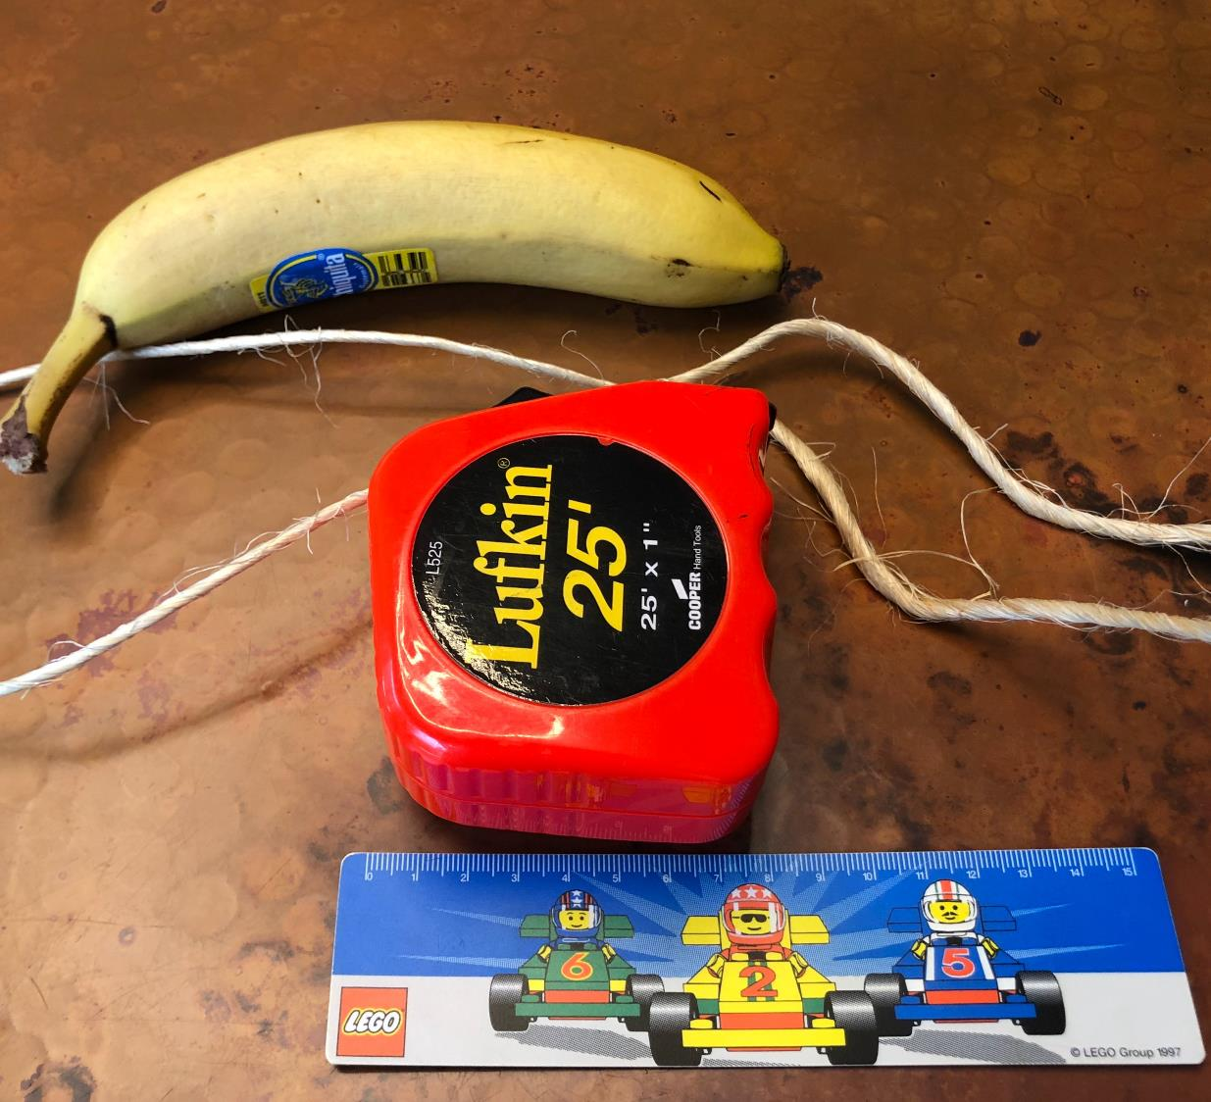
Our measurement (answer) is:

Slide 38

Facility Name: TEAM 1
Activity:
How to Measure a Banana
_Find a banana, string and ruler with cm calibration
_Locate head (start) and toe (finish) of the banana
_Using the string measure straight from head of banana to toe of banana
_Then measure the length on a ruler and document measurement in cm
-Repeat the procedure measuring banana from the head round the upper curve of the banana to toe of banana
-Repeat the procedure measuring the banana from the head round the lower curve of the banana to toe of banana
-Repeat the procedure measuring the banana right round the thickest part of the banana (circumference)

Slide 39
Facility Name:
Worksheet for Testing Change
Initial PDSA
Aim #3: Increase VL coverage
Describe your first (or next) test of change Person responsible By When Where
Reminding clients of appointments using SMS for viral load sample collection Clinician
I week before At faciliy appointment
By When Where
Pers
PLAN
Insufficient
List the tasks needed to set up this test of change
details
on responsible
1. Print the appointments list for the clients from EPMS
1. DEC
1. Monthly
prediction succeeds
Clinic
Me
No measure
Predict what will happen when the test is carried out
Prediction missing
asures to determine if
DO
Describe what actually happened when you ran the test:
STUDY
Describe the measured results and how they compared to the predictions:
ACT (select one)
q Adopt à Standardize
q Adapt à Describe what modifications to the plan will be made for the next cycle
q Abandon

Slide 40
The Model for Improvement (IHI)
Aim
Measure Change
What are we trying to accomplish?
How will we know that a change is an improvement?
What change can we make that will result in improvement?
Act
Plan
Do
Small tests of change
Study

Slide 41
Plan
D
List the tasks needed to set up this test of change | Person responsible | When to be done | Where to be done
Create SOP | ME | 7/31 | Virtual
Create Ordered List of all Participants | ME | 7/31
Notify participants | Fortunate | 8/3
Implement | ME | 8/5
Predict what will happen when the test is carried out | Measures to determine if prediction succeeds
Predict that 80% of teams/sites will be able to unmute and introduce themselves on August 5. Predict that > 75% of participants will either be satisfied or very satisfied with the change in introductions. | % of sites who introduce themselves=# sites who introduce / # of all sites on List X 100 Customer Satisfaction Zoom Poll satisfaction rating
Do
Describe what actually happened when you ran the test
Study
Describe the measured results and how they compared to the predictions
Worksheet for Testing Change
Act
Describe what modifications to the plan will be made for the next cycle from what you learned

Slide 42
Facility Name:
Worksheet for Testing Change
Initial PDSA
e By Wh
Aim #3: Increase VL coverage
Waste – Misutilization
Describe your first (or next) test of change
Person responsibl
of skills
en
Where
Reminding clients of appointments using SMS for viral load sample collection
Clinician
I week before
At faciliy
Pers
appointment
PLAN
Insufficient
List the tasks needed to set up this test of change
details
on responsible
By When
Where
1. Print the appointments list for the clients from EPMS
1. DEC
1. Monthly
prediction succeeds
Clinic
Me
No measure
Predict what will happen when the test is carried out
Prediction missing
asures to determine if
DO
Describe what actually happened when you ran the test:
STUDY
Describe the measured results and how they compared to the predictions:
ACT (select one)
q Adopt à Standardize
q Adapt à Describe what modifications to the plan will be made for the next cycle
q Abandon

Slide 43
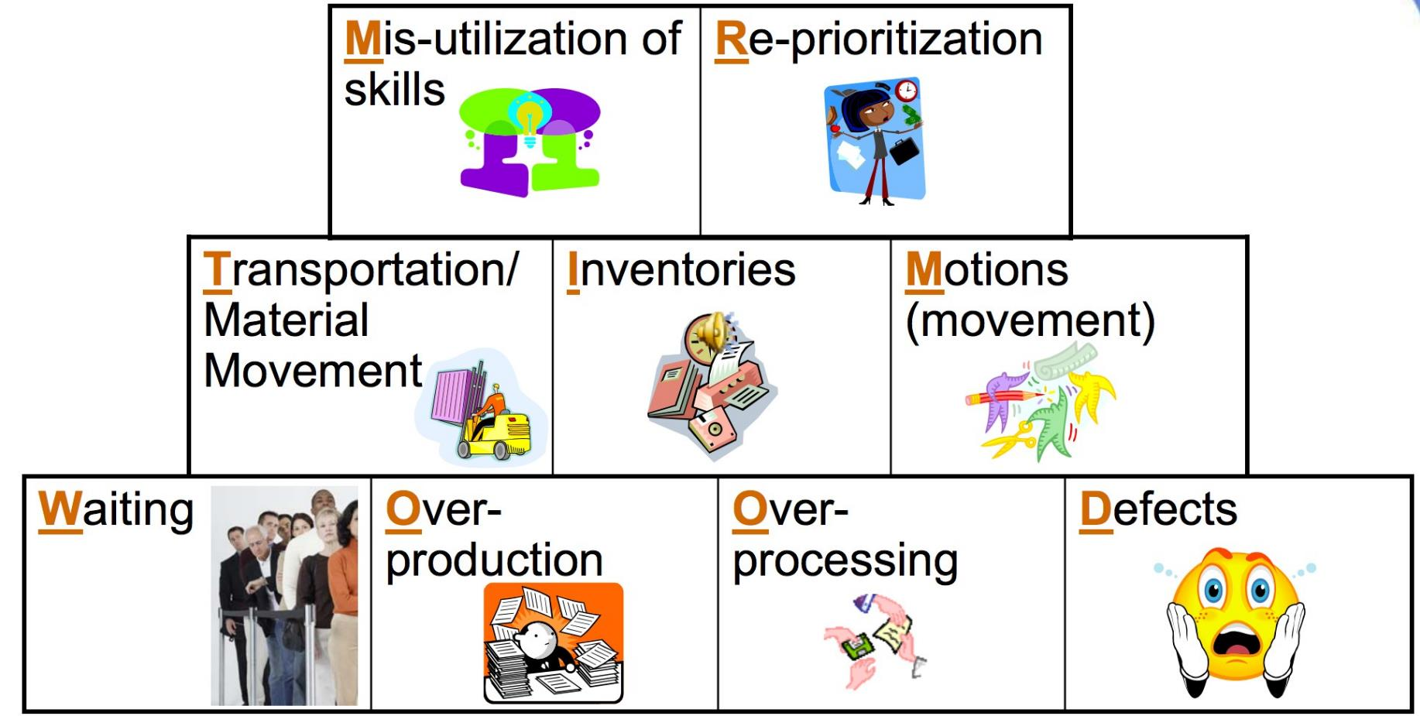
Types of Waste – MR TIM WOOD

Slide 44
Facility Name:
Worksheet for Testing Change
Initial PDSA
New change or
e By Wh
Aim #3: Increase VL coverage
implementation
Waste – Misutilization
Describe your first (or next) test of change
issue
Person responsibl
en
Where
of skills
Reminding clients of appointments using SMS for viral load sample collection
Clinician
I week before
At faciliy
Pers
appointment
PLAN
Insufficient
List the tasks needed to set up this test of change
details
on responsible
By When
Where
1. Print the appointments list for the clients from EPMS
1. DEC
1. Monthly
prediction succeeds
Clinic
Me
No measure
Predict what will happen when the test is carried out
Prediction missing
asures to determine if
DO
Describe what actually happened when you ran the test:
STUDY
Describe the measured results and how they compared to the predictions:
ACT (select one)
q Adopt à Standardize
q Adapt à Describe what modifications to the plan will be made for the next cycle
q Abandon

Slide 45
Facility Name:
Worksheet for Testing Change
Initial PDSA
Aim #3: VL Coverage
Describe your first (or next) test of change | Person responsible | By When | Where
Appointment System - Reminding clients of appointments using SMS for VL | Clinician | SMS by Sept 25; VL by Sept 29 | Clinic
PL
AN
List the tasks needed to set up this test of change | Person responsible | By When | Where
1) ID Eligible - Mar 2020 cohort – Print list | DEC | Monday | Clinic
2) Develop brief SOP with script | Dignity | Monday
3) Assure air time & needed resources | Lucia | Monday
4) Schedule test / Call clients | Liberty | Tuesday
5) Asses number of clients that respond & come for VL | DEC | Tuesday, Sept 29
DO
Predict what will happen when the test is carried out | Measures to determine if prediction succeeds
Predict that 60% of clients called will respond & come for VL within 1 week | Metric #1 – Clients who received intervention/All clients in cohort, Metric #2 – Clients with VL drawn / All clients in cohort
Describe what actually happened when you ran the test:
Describe the measured results and how they compared to the predictions:
UDY
ST
ACT (select one)
q Adopt à Standardize
q Adapt à Describe what modifications to the plan will be made for the next cycle
q Abandon

Slide 46
PDSA Plans: Case Study #2

Slide 47
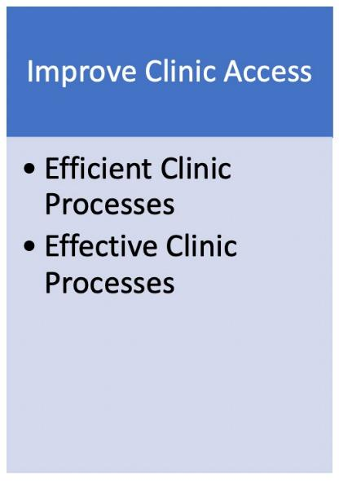
Facility Name: Parirenyatwa OI Clinic
CHANGES to Test
Patient flow to allow for screening and bleeding of those eligible before getting into consultation rooms.
Process Map – Opportunities for Improvement (OFI)
Documentation of sample collection in the patients OPD card
HIO (Booking Officer) to check for signature of the phlebotomist.
VL sample collection to be done before patient
goes for consultation of stable patients
Voice of Customer (VOC)
Clients complain of long waiting period, from consultation to VL bleeding queues.
Root Cause Analysis (RCA)
1. Clinic processes, patient low delays clients due for VL to have their sample collected.

Slide 48
Facility Name:
Worksheet for Testing Change
Initial PDSA
Aim #3:
Describe your first (or next) test of change Person responsible By When Where
PLAN
Person respo
NOT Filled
List the tasks needed to set up this test of change
nsible
By When
Where
Predict what will happen when the test is carried out | Measures to determine if prediction succeeds
DO
Describe what actually happened when you ran the test:
STUDY
Describe the measured results and how they compared to the predictions:
ACT (select one)
q Adopt à Standardize
q Adapt à Describe what modifications to the plan will be made for the next cycle
q Abandon

Slide 49
Facility Name:
Worksheet for Testing Change
Initial PDSA
Aim #3: VL Coverage
Describe your first (or next) test of change | Person responsible | By When | Where
Redesign Clinic Flow – Screening & Bleeding à Consultation | Clinician | Monday, Sept 28
PL
List the tasks needed to set up this test of change | Person responsible | By When | Where
Brief SOP / Process map with new process Meet with staff, walk new process, assuring structure matches process Update process table / assign appropriate staff Implement | T U V W | Thursday Friday Friday Monday, Sept 21
AN
Predict what will happen when the test is carried out | Measures to determine if prediction succeeds
Process – 95% of eligible clients that arrive in clinic will have VL O Outcome – Metric 2 & 3 | Process - # eligible clients that arrive @ clinic/# with VL sample collected X 100 Outcome – Metric 2 & 3
Describe what actually happened when you ran the test:
D
STUDY
Describe the measured results and how they compared to the predictions:
ACT (select one)
q Adopt à Standardize
q Adapt à Describe what modifications to the plan will be made for the next cycle
q Abandon

Slide 50
PDSA Plans: Case Study #3

Slide 51
Facility Name: Labs
CHANGES to Test
Process Map – Opportunities for Improvement (OFI)
1.Post testing TAT too long
2.
3.
Relay results via SMS to facility
( Mbare Polyclinic).
Voice of Customer (VOC)
1.Overall TAT too long
2.
3.
Root Cause Analysis (RCA)
1.Pre and Post TAT too long
2.
3.

Slide 52
Facility Name: BRIDH & NMRL Labs
Worksheet for Testing Change
Initial PDSA
Aim #3: Reducing Post analytic TAT from---- days to ----days by 25 September 2020
Describe your first (or next) test of change | Person responsible | By When | Where
Redesign the result relaying through use of SMS | IT Officer | 25/09/20 | Lab( NMRL & BRIDHL)
PLAN
List the tasks needed to set up this test of change |  | Person responsible | By When | Where
1.Engage IT to modify system 2.Resource Mobilize. 3. Visit/virtual meeting with Mbare PC 4.Write SOP. 5. Sensitise on SOP 6. Implement |  | Team Lead ( Zvana) IT Officer | 22/09/20 | Lab( NMRL & BRIDHL)
Predict what will happen when the test is carried out | Measures to determine if prediction succeeds
Post TAT will be reduced to 2 days
DO
Describe what actually happened when you ran the test:
STUDY
Describe the measured results and how they compared to the predictions:
ACT (select one)
q Adopt à Standardize
q Adapt à Describe what modifications to the plan will be made for the next cycle
q Abandon

Slide 53
CHANGES Menu* (Lab)
Think - Process Redesign
Test Result Communication
Redesign Process of Result Delivery / Utilization via SMS or Email - Clinic/Lab Interface
Sample Rejection Communication
Redesign Sample Rejection Process, including notification of sending facility
*Other CHANGE, upon request

Slide 54
PDSA Plans: Case Study #4

Slide 55
Facility Name:
Worksheet for Testing Change
Initial PDSA
Aim #3:
Describe your first (or next) test of change | Person responsible | By When | Where
Synchronize drug pick up and viral load sample collection | OI Nurse | 30 September 2020 | Hatcliffe OI department
PLAN
List the tasks needed to set up this test of change
Person responsible
By When
Where
Cohort clients , give clients enough medicines to coincide with VL sam
ple OI Nurse
Measures to determin
Number of clients who
30 September
Hatcliffe OI clinic
collection date
NOTHING has
2020
Predict what will happen when the test is carried out
e if prediction succeeds
95% eligible for VL will be bled and fewer clients will be missed for VL
actually happened yet
had Viral load sample collection
sample collection
DO
Describe what actually happened when you ran the test:
90% clients had a valid VL by 30 September from 50%
STUDY
Describe the measured results and how they compared to the predictions:
A change to improvement took place.
ACT (select one)
q Adopt à Standardize
q Adapt à Describe what modifications to the plan will be made for the next cycle
q Abandon

Slide 56
PDSA Plans: Case Study #5

Slide 57
Facility Name:
Worksheet for Testing Change
PDSA # & Cycle
Aim #3:
Describe your first (or next) test of change | Person responsible | By When | Where
PLAN
List the tasks needed to set up this test of change | Person responsible | By When | Where
Predict what will happen when the test is carried out | Measures to determine if prediction succeeds
DO
Describe what actually happened when you ran the test:
STUDY
Describe the measured results and how they compared to the predictions:
ACT (select one)
q Adopt à Standardize
q Adapt à Describe what modifications to the plan will be made for the next cycle
q Abandon

Slide 58
Facility Name:
Worksheet for Testing Change
Change Idea A
Aim #3: VL Coverage
Describe your first (or next) test of change | Person responsible | By When | Where
Redesign the client appointment process – Appointment creation - Sticker alert for the next appointment | Japhet | Friday, Sept 18 | ART Clinic at the Wakunda Hospital
PLAN
List the tasks needed to set up this test of change | Person responsible | By When | Where
1) Procure stickers | Romana | Tuesday, Sept 15 | Amazon
2) Write a brief SOP | Japhet | Tuesday, Sept 15 | Virtual
3) Select OI/ART nurse – schedule day, time, population, location for test | Phyllis | Tuesday, Sept 15 | Virtual
4) Train Nurse on SOP | Phyllis | Wed, Sept 16 | Virtual
Predict what will happen when the test is carried out | Measures to determine if prediction succeeds
Nurse will find it easy to place stickers Clients will be accepting of the stickers | Will assess client and patient satisfaction with process
Describe what actually happened when you ran the test: Nurse found new CHANGE to be agreeable to clients, but stickers were hard to remove from paper 3 clients said that they thought it would help them to see the appointment better in their book
DO
STUDY
Describe the measured results and how they compared to the predictions:
Nurse not satisfied, so does not agree with predication Client – liked new process
ACT (select one)
q Adopt à Standardize
q Adapt à will purchase new stickers (fortunately only bought one box of old stickers), proceed to Change Idea A, PDSA #2
q Abandon

Slide 59
Facility Name:
Worksheet for Testing Change
PDSA # & Cycle
Aim #3: VL Coverage
Describe your first (or next) test of change | Person responsible | By When | Where
Redesign the client appointment process – SMS Reminders for appointment
PLAN
List the tasks needed to set up this test of change | Person responsible | By When | Where
Predict what will happen when the test is carried out | Measures to determine if prediction succeeds
 | Viral load samples drawn (Metric 2) & results recorded in green books (Metric 3)
DO
Describe what actually happened when you ran the test:
STUDY
Describe the measured results and how they compared to the predictions:
ACT (select one)
q Adopt à Standardize
q Adapt à Describe what modifications to the plan will be made for the next cycle
q Abandon

Slide 60
Facility Name:
Worksheet for Testing Change
PDSA # & Cycle
Aim #3: VL Coverage
Describe your first (or next) test of change | Person responsible | By When | Where
Redesign the client appointment process – New Process with electronic appointment, sticker communication, and SMS reminder
PLAN
List the tasks needed to set up this test of change | Person responsible | By When | Where
Predict what will happen when the test is carried out | Measures to determine if prediction succeeds
 | Viral load samples drawn (Metric 2) & results recorded in green books (Metric 3)
DO
Describe what actually happened when you ran the test:
STUDY
Describe the measured results and how they compared to the predictions:
ACT (select one)
q Adopt à Standardize
q Adapt à Describe what modifications to the plan will be made for the next cycle
q Abandon

Slide 61
PDSA Plans: Refine

Slide 62

Breakout Room
Refine PDSA Plans
Based on the overall feedback,
Refine / Update the PDSA Worksheet for the PDSA that you will test next week and the one for the following week
Facilitator to record PDSA Plans on the Templates
Outputs:
q 2 PDSA Worksheets

Slide 63
QI Panel
Special Guests

Slide 64

Ms. Winnie Shena
CEO
Kenya Obstetrical and Gynecology Society

Slide 65

Dr. Talkmore Maruta
Senior Biosafety and Biosecurity Officer
Africa Centres for Disease Control and Prevention

Slide 66

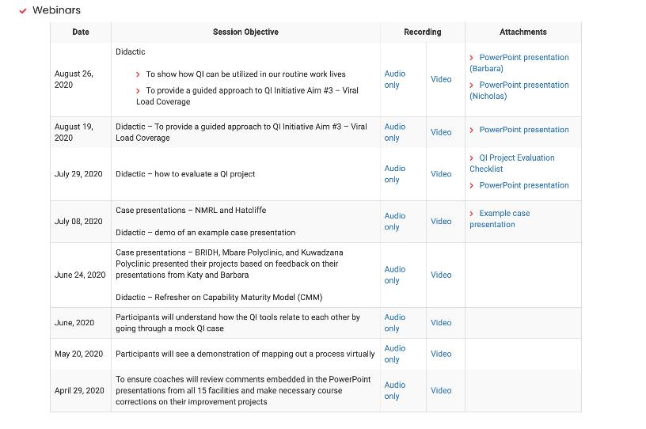
Missed a Meeting?
Check out the recorded sessions on the LARC Website:
https://www.larccqi.org/impl ementations/zimbabwe

Slide 67
Data Collection

Slide 68
Facility Name:
Data Collection Plan
Measure
Who | DEC
How Often | Monthly, on first day of month following end of period (6 or 7 months)
What | Metric #1 - # Patients who received Intervention within 6 months / Total # of patients in the cohort Metric #2 - # Patients whose blood was drawn within 6 months / Total # of patients in the cohort Metric #3 - # Patients with documented VL result in green book within 7 months / Total # of patients in the cohort
Where | Clinic
How | Metric #1 – Intervention tracking log Metric #2 & #3 – Green books
Training | @ LS #3, Reviewed at site by 09.18.20
Sustainability – See Control Plan | Data Collection Process documented Data tracked monthly and posted on Learning Board, reported to facility leadership

Slide 69

I |  | Metric 1
Cohort |  | % Intervention completed | % patients bled for VL testing | % patients with VL resutls documented in Greenbook
I
I | Mar-20
Apr-20
I | May-20
I
Metric 2
Metric 3
I
I
 | % Intervention completed | % patients bled for VL testing | % patients with VL resutls in Greenbook
Numerator | # patients who received the intervention within 6 months of cohort initiation | # patients whose blood was drawn within 6 months of cohort initiation | # patients with documented VL results in Greenbook within 7 months of cohort initiation
Denominator | total# patients in the cohort | total # patients in the cohort | total# patients in the cohort

Slide 70

,, | .., | .... | ..,
 | Metric 1 | Metric 2 | Metric3
Patients in the cohort 1 2 3 4 5 6 7 8 9 10 11 12 13 14 ... ... (add more rows) | Did the patient receive the intervention? Yes/No | Was the patient bled for VL testing? Yes/No | Was the patient's VL resutls documented in Greenbook? Yes/No
I
Numerator
(Total# Yes)
(Total# Yes)
(Total# Yes)
I
I
Denominator
,.. (Total# patients in this cohort)
,.
(Total# patients in this cohort)
,.
(Total# patients in this cohort)
Metric (in %) =
#VALUE!
#VALUE!
#VALUE!

Slide 71

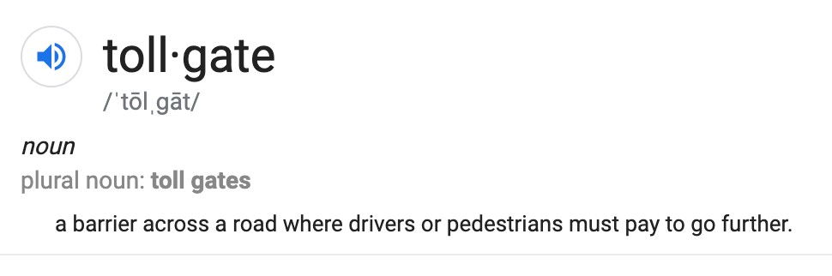
The Six Sigma DMAIC problem solving methodology is accomplished in five phases, or steps: Define, Measure, Analyze, Improve and Control. Between each phase or step many companies employ a “tollgate” to control the
process. Only when the person leading the project confirms that the team has successfully completed the previous phase may they pass the tollgate and move to the next phase.

Slide 72
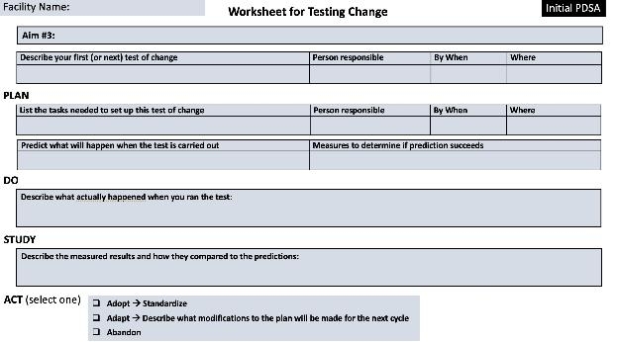
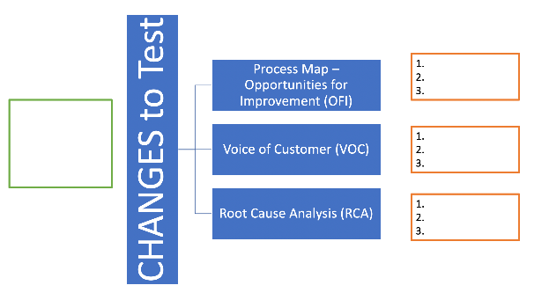
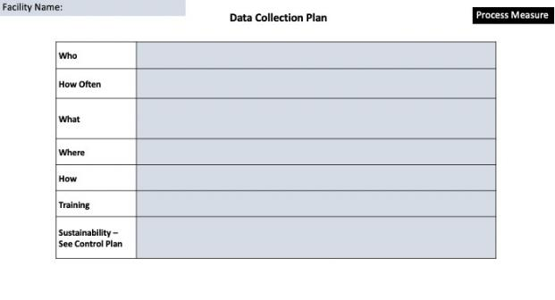
Deliverables
PDSA Worksheet / Plan
Select CHANGE
Data Collection Plan

Slide 73
Appreciative Debrief

Slide 74

Thank You
Please take the poll!

